Slide 1
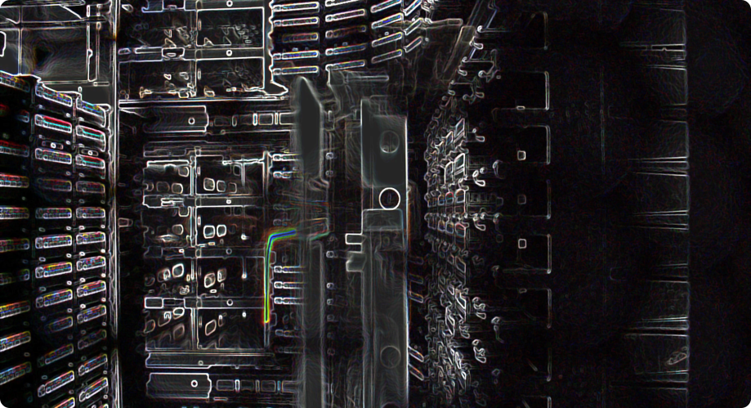
Deep learning
Deep learning with Keras

Slide 2
Today’s program
14:00-14:30 What is ML / DL? What is a neuron?
14:30-15:30 Hands on: building a neuron from scratch
15:30-15:45 How do neural networks work?
15:45-16:15 Break
16:15-16:30 How do neural networks work? (continued)
16:30-17:15 Hands on: building a network from scratch
17:15-18:00 Loss function & updating weights
18:00-19:00 Diner
19:00-19:45 Hands on: the XOR problem
19:45-20:00 Dataset splitting & Performance evaluation
20:00-21:00 Hands on: Keras on fashion Mnist
If we finish early: Machine learning tasks (classification vs regression)

Slide 3
A step back
What do we want to achieve with our neural networks?
We want to input data and get out some meaningful result.
In machine learning this problem is formulated so that we have a task which we want to perform.
Regression
Classification
Clustering
Network
Task
Dataset
Input
Evaluates
Measure

Slide 4
A step back
Alongside the task we have some input, usually in the form of a dataset.
When the have some metric / measure which can evaluate how well we are performing the task.
Accuracy
F1 score
Area-under-curve (AUC)
Network
Task
Dataset
Input
Evaluates
Measure

Slide 5
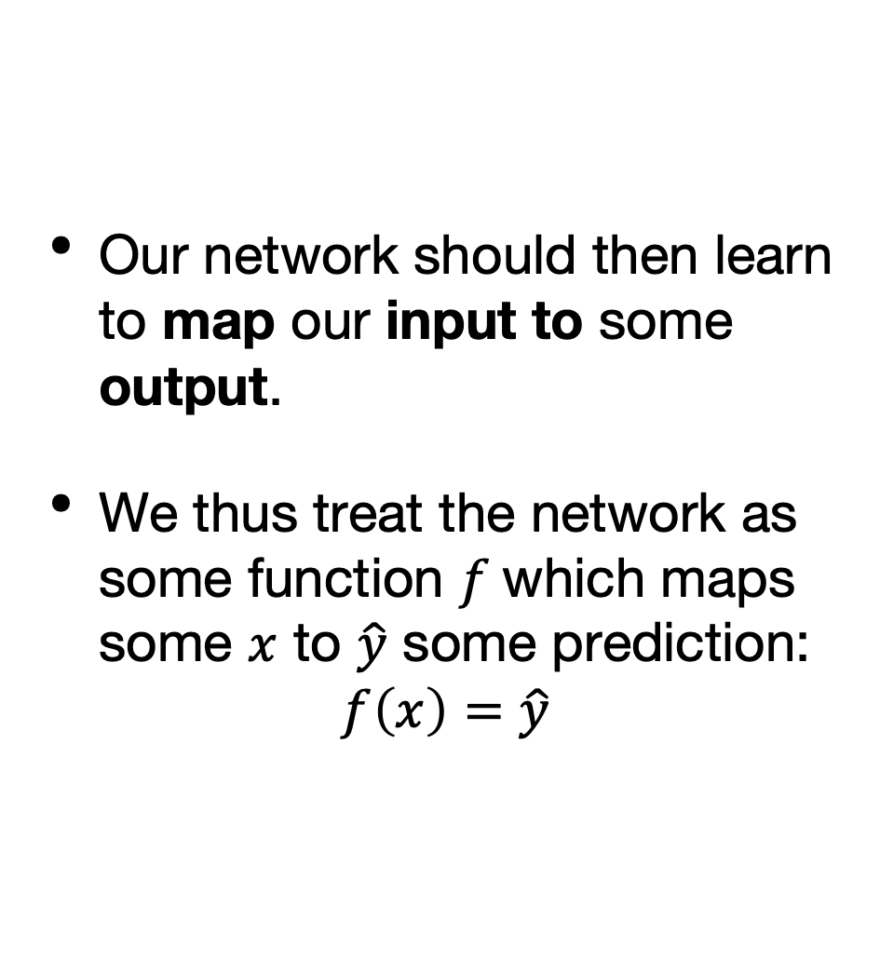
A step back
Our network should then learn to map our input to some output.
We thus treat the network as some function $f$which maps some $x$ to $\hat{y}$ some prediction:
$$f\left(x\right)=\hat{y}$$
Network
Task
Dataset
Input
Evaluates
Measure

Slide 6
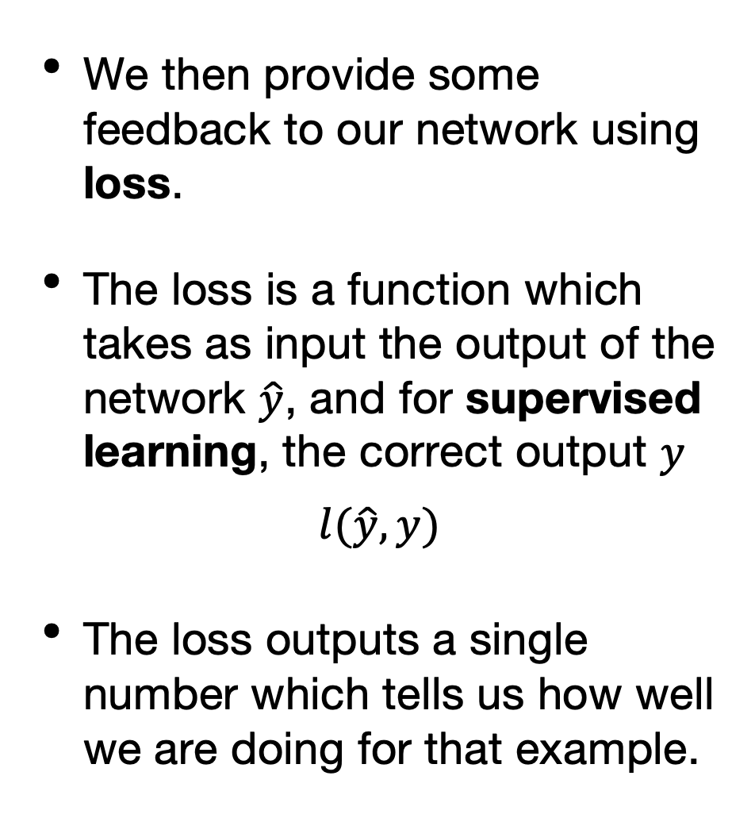
Supervised learning
We then provide some feedback to our network using loss.
The loss is a function which takes as input the output of the network $\hat{y}$, and for supervised learning, the correct output $y$
$$l(\hat{y},y)$$
The loss outputs a single number which tells us how well we are doing for that example.
Network
Task
Dataset
Input
Evaluates
Measure

Slide 7
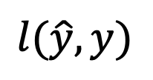
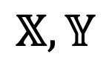
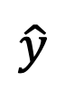
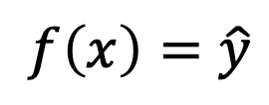
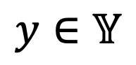
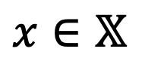
Supervised learning
The loss should be large when we are performing poorly and low (or 0) when we are performing well.
The loss function is dependent on the task at hand.
We do not use the metric to provide feedback to the network for technical reasons.
Network
Dataset
$$x∈𝕏$$
$$f\left(x\right)=\hat{y}$$
$$𝕏,𝕐$$
$$\hat{y}$$
$$y∈𝕐$$
$$l(\hat{y},y)$$
Loss
Notes:
Metrics are typically not differentiable, making them unsuitable for optimisation purposes
Metrics give you some indication of model performance for your domain

Slide 8
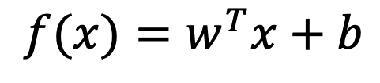
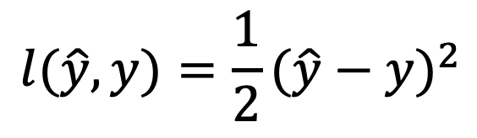
Example: Linear Regression
For example, if we map our inputs directly to an output using:
And use this loss:
we get linear regression.
Network
Dataset
$$x∈𝕏$$
$$f\left(x\right)=\hat{y}$$
$$𝕏,𝕐$$
$$f(x)=w^{T}x+b$$
$$\hat{y}$$
$$y∈𝕐$$
$$l(\hat{y},y)=\frac{1}{2}(\hat{y}−y)^{2}$$
$$l(\hat{y},y)$$
Loss

Slide 9
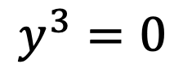
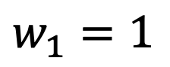
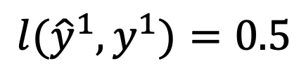
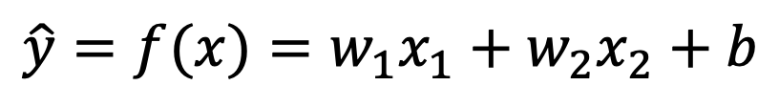
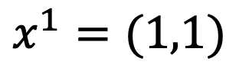
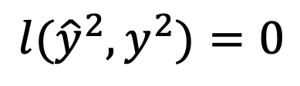
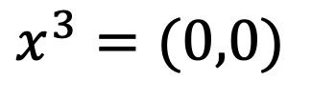
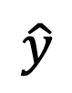
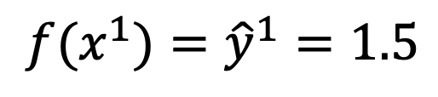
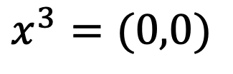
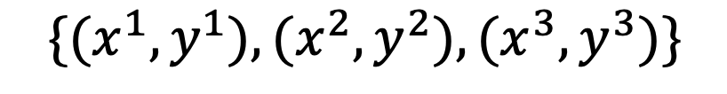
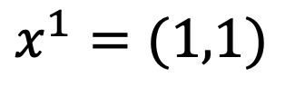
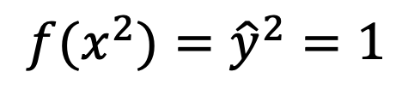
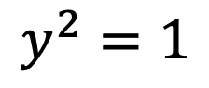
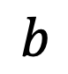
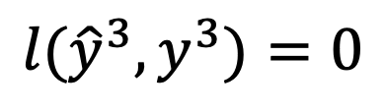
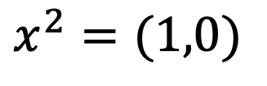
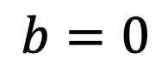
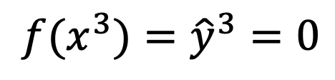
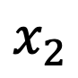
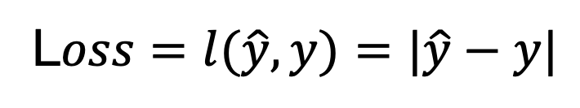
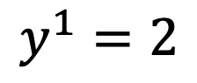
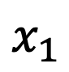
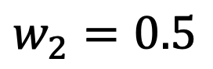
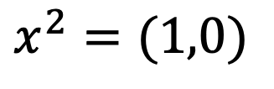
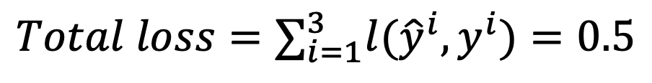
Understanding loss
3 data points
$$\{(x^{1},y^{1}),(x^{2},y^{2}),(x^{3},y^{3})\}$$
L$oss=l(\hat{y},y)=|\hat{y}−y|$
$$x^{1}=(1,1)$$
$$y^{1}=2$$
$$Total loss=∑_{i=1}^{3}l({\hat{y}}^{i},y^{i})=0.5$$
$$x^{2}=(1,0)$$
$$y^{2}=1$$
$$x^{3}=(0,0)$$
$$y^{3}=0$$
Network predictions
$$x_{1}$$
$$w_{1}=1$$
$$\hat{y}=f(x)=w_{1}x_{1}+w_{2}x_{2}+b$$
$$x^{1}=(1,1)$$
$$f(x^{1})={\hat{y}}^{1}=1.5$$
$$l({\hat{y}}^{1},y^{1})=0.5$$
$$w_{2}=0.5$$
$$\hat{y}$$
$$x_{2}$$
$$x^{2}=(1,0)$$
$$f(x^{2})={\hat{y}}^{2}=1$$
$$l({\hat{y}}^{2},y^{2})=0$$
$$x^{3}=(0,0)$$
$$f(x^{3})={\hat{y}}^{3}=0$$
$$l({\hat{y}}^{3},y^{3})=0$$
$$b$$
$$b=0$$

Slide 10
Minimising loss
We then seek to minimise the loss over the whole dataset.
To minimise the loss we adjust the weights of the network so that the loss decreases.
We then seek to find the weights of the network which minimises the loss.
Network
Dataset
$$x∈𝕏$$
$$f\left(x\right)=\hat{y}$$
$$𝕏,𝕐$$
$$\hat{y}$$
$$y∈𝕐$$
$$l(\hat{y},y)$$
Loss

Slide 11
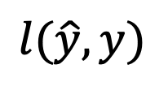
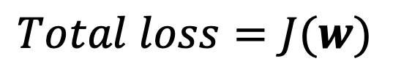
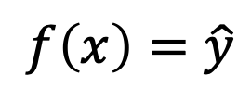
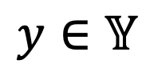
Updating weights
How do we systematically update the weights to reduce loss?
If our loss and network are made by using differentiable functions, we simply differentiate the total loss w.r.t. the weights and update the weights with that information.
There are lots of finer details to this but the important part to know is that each weight contributes to the total loss.
This means that our loss function over the whole dataset is high-dimensional function, as it is a function of every weight in the network.
Network
Dataset
$$x∈𝕏$$
$$f\left(x\right)=\hat{y}$$
$$𝕏,𝕐$$
$$\hat{y}$$
$$y∈𝕐$$
$$l(\hat{y},y)$$
Loss
$$Total loss=J(w)$$
All the weights in a single vector

Slide 12
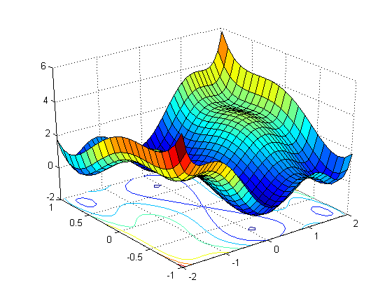
Loss
W2
W1
Source: Introduction to loss functions
Notes:
This is the loss surface for two weights: W1 and W2
We want to go down the loss surface, and need to follow the slope

Slide 13

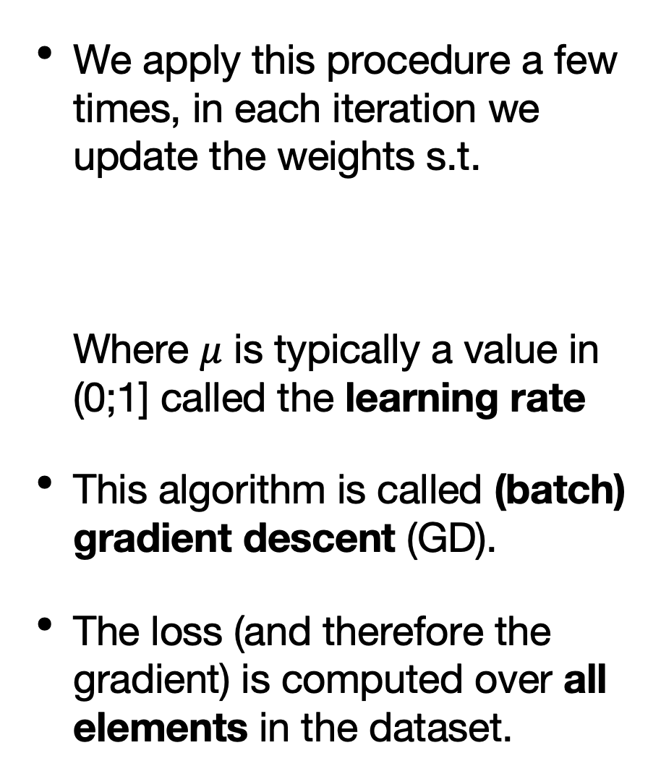
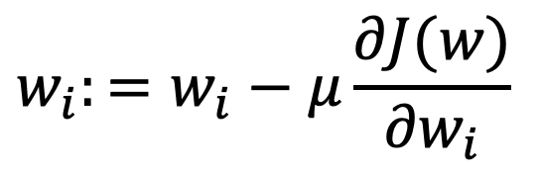
Updating weights
(batch) Gradient descent
We apply this procedure a few times, in each iteration we update the weights s.t. Where $μ$ is typically a value in (0;1] called the learning rate
This algorithm is called (batch) gradient descent (GD).
The loss (and therefore the gradient) is computed over all elements in the dataset.
$$w_{i}:=w_{i}−μ\frac{∂J(w)}{∂w_{i}}$$
Source: Gradient optimization

Slide 14
Updating weights
(Batch) Gradient descent
We are not guaranteed to find a global minimum of the loss function using GD.
In practice, it tends to find pretty good local minima.
Source: Introduction to loss functions
Notes:
Global optimum is not necessarily what we want, because we are probably overfitting a lot at that point

Slide 15
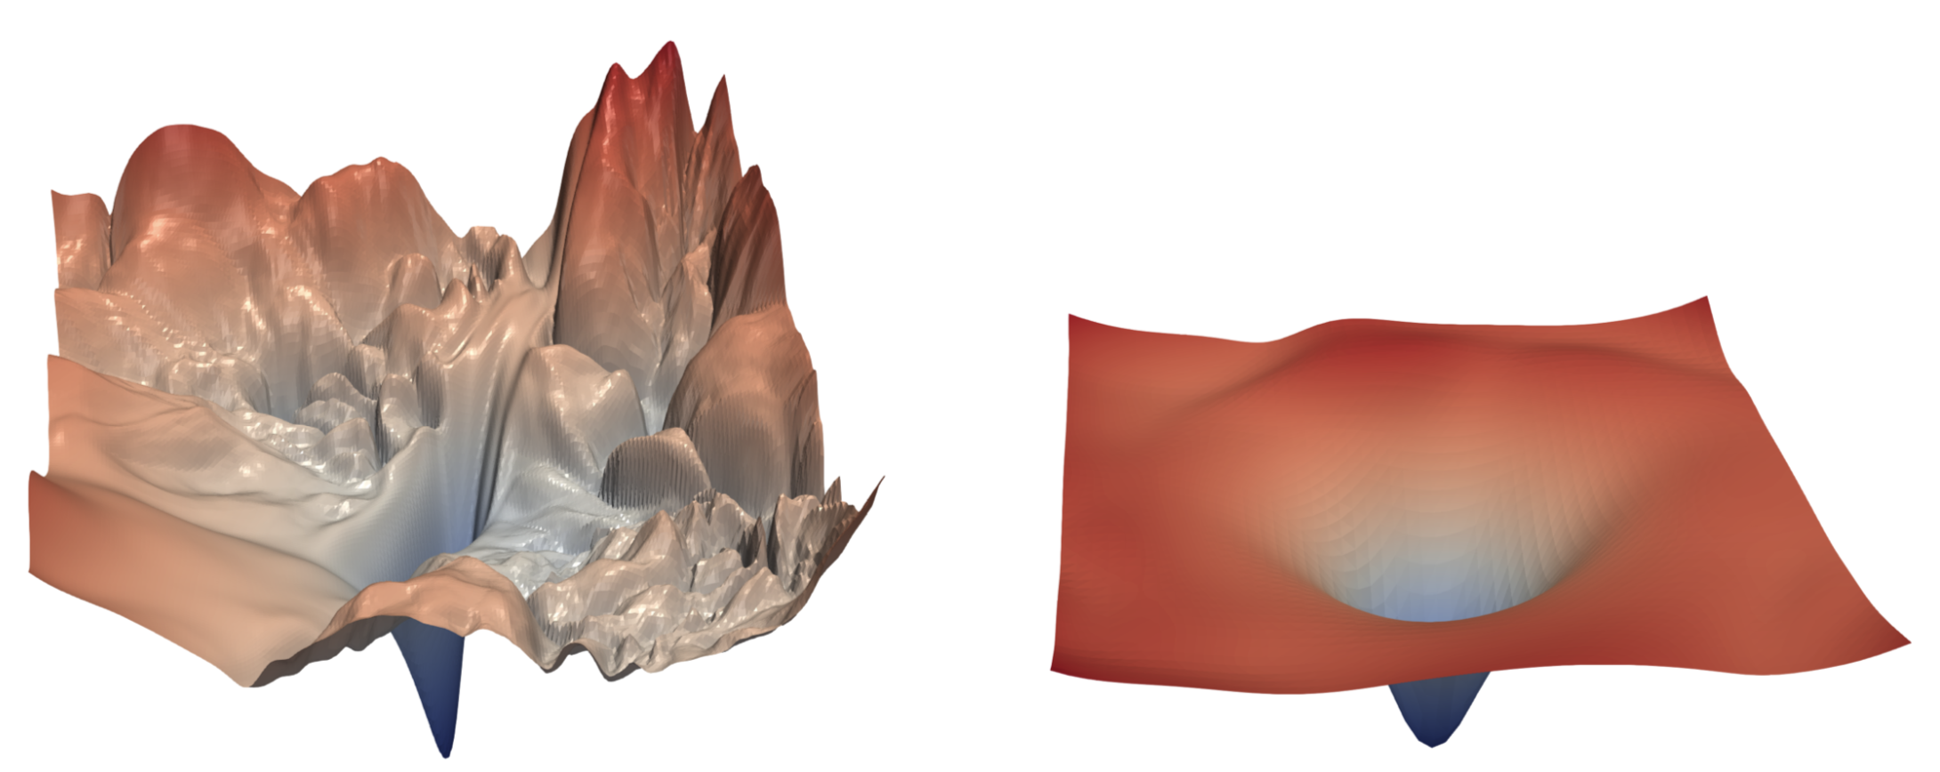
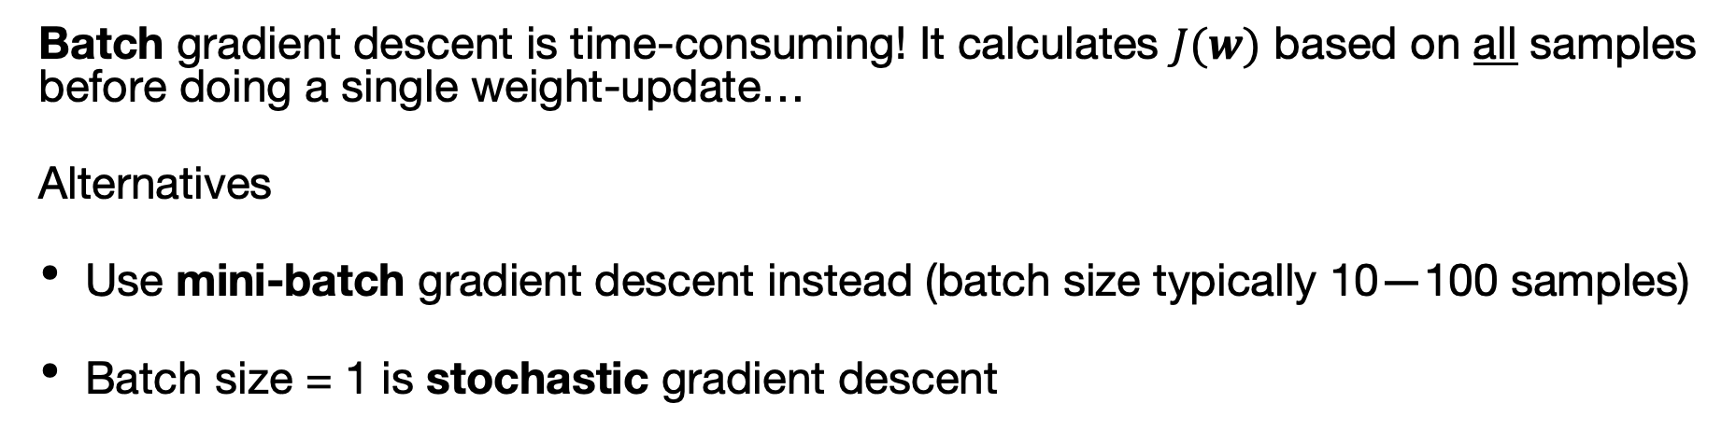
Updating weights
Batch gradient descent is time-consuming! It calculates $J(w)$ based on all samples before doing a single weight-update…
Alternatives
Use mini-batch gradient descent instead (batch size typically 10—100 samples)
Batch size = 1 is stochastic gradient descent
Notes:
Batch gradient descent expects relatively smooth loss surfaces like the one on the right, but more often our surface looks like the one on the left
For reasons of performance we use mini-batches of data rather than ordinary batch gradient descent
It will cause our total loss to not always decrease, but runs faster.
Batch size = m (the whole dataset) is equivalent to GD.
Batch size = 1 is called stochastic gradient descent.
We iterate through the dataset many times, the number of times is the epoch, another hyperparameter.

Slide 16
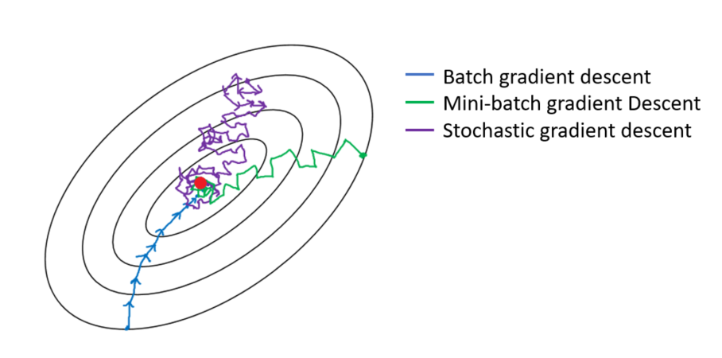
Updating weights
Mini-batch gradient descent
Source: Andrew Ng, deep learning course, Coursera

Slide 17
The problem of small batches
SGD considers 1 sample per iteration => bad approximation of the real optimization surface
Thus, gradient direction & size vary substantially between iterations
Various optimizers mitigate this problem by some form of averaging of direction and / or step size (e.g. Adam)
Notes:
Adam: Adaptive moment optimization
Instead of a single learning rate, we have a learning rate per parameter
We incorporate something similar to a momentum term, where past gradients have some effect on the current gradient as well. This speeds up training.
Adam is quite robust and reliable, and usually quite fast
We are solving a modified XOR problem with Keras

Slide 18
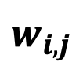
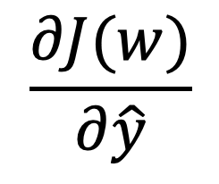
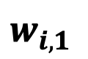



Applying GD in DL
Backpropagation
$$\frac{∂J(w)}{∂\hat{y}}⋅\frac{∂\hat{y}}{∂a_{i}}⋅\frac{∂a_{i}}{∂w_{i,j}}$$
In the context of DL we need to compute the gradient for each layer.
We do this by applying the chain rule of derivatives.
This algorithm is known as backpropagation.
$$\frac{∂J(w)}{∂\hat{y}}⋅\frac{∂\hat{y}}{∂w_{i}}$$
$$w_{i,j}$$
$$w_{i,1}$$
...
$$\hat{y}$$
$$\frac{∂J(w)}{∂\hat{y}}$$
...
Notes:
Backprop sends stronger "error signals" to nodes which contributed a lot to the overall error, and will update these weights more strongly than others

Slide 19

Keras -> TensorFlow
We do not need to worry at all about updating these weights and differentiating since this is done by the framework (TensorFlow).
It is still important to know what is happening when you need to debug your network.
Source: https://www.tensorflow.org/guide/graphs

Slide 20




Creating neural networks
Many frameworks exist; TensorFlow, CNTK, Torch, Keras, Theano, Caffe, ...
We will use Keras (https://keras.io/)
Keras used to call TensorFlow as a ‘backend’, but is now fully integrated in TensorFlow.

Slide 21

Hands-on
Go to https://https://jupyter.lisa.surfsara.nl:8000/
Notebook: 02a-keras-on-xor.ipynb
19:00-19:45

Slide 22
Today’s program
14:00-14:30 What is ML / DL? What is a neuron?
14:30-15:30 Hands on: building a neuron from scratch
15:30-15:45 How do neural networks work?
15:45-16:15 Break
16:15-16:30 How do neural networks work? (continued)
16:30-17:15 Hands on: building a network from scratch
17:15-18:00 Loss function & updating weights
18:00-19:00 Diner
19:00-19:45 Hands on: the XOR problem
19:45-20:00 Dataset splitting & Performance evaluation
20:00-21:00 Hands on: Keras on fashion Mnist
If we finish early: Machine learning tasks (classification vs regression)

Slide 23


Evaluating performance
Exercise 5’s decision boundary does not generalise
Use a test set to estimate performance on unseen examples
Notes:
In the notebook we saw that we were able to perform very well (even perfectly!) on our training dataset.
But the problem is that you would not expect this decision boundary to generalise well to new examples.
To test such generalisation we need to evaluate our model against a dataset which it was not trained on, the test set. In this case, we see that the decision boundary is far too specific to the original data set, and shows severely reduced performance on our test set (right).

Slide 24
Evaluating performance
Hyperparameters affect performance
learning rate
batch size
# layers
# neurons
We need to test combinations manually
We test different hyperparameters on a validation set
Notes:
Our model contains various hyperparameters which we need to set which affect our performance.
learning rate
batch size
# layers
# neurons
To get the best results on the test set we might need to test many different combinations of them.
Testing all these combinations on the test set is not a great idea as we want to know how well our model actually performs on never seen before data.
To fix this we test different hyperparameters on a third dataset, a validation / development set.

Slide 25

Early stopping
Overfitting
Notes:
Given sufficient capacity, the loss on the training set will keep decreasing
The validation set loss will decrease up to a point, after which it will start increasing again. We start overfitting.
One way to control overfitting is to do early-stopping: identify the point at which we start overfitting, and stop training there. This is what we will do in the assignment.
Early-stopping is generally discouraged in favour of dropout and regularisation: techniques we will discuss next session.

Slide 26

Underfitting
Notes:
Even after many epochs, the loss does not get close to 0. The model does not have enough capacity. Increase the number of layers and/or neurons.

Slide 27



Training, validation, testing
Training set
Validation set
Test set
Model training
Model selection
Model testing
Best model parameters Weights
Best hyperparameters Learning rate
#neurons
#layers
Final model Accuracy
Sensitivity/specificity
Notes:
Specific to deep learning are the tweaking of the different hyperparameters, and how overfitting/underfitting develops given model capacity and optimization

Slide 28

Source: Cross Validation & Ensembling
Notes:
Minimise information leakage across the different sets
Validation set should not know anything about the training set and vice versa, same for the test set
You don’t want samples that are somehow correlated (e.g. data from the same patient, measured at different times) in the training AND test set

Slide 29
Evaluating performance
We generate the validation and test sets ourselves by splitting the original data set.
Typically, people split their train/val/test set as 70/10/20.
Source: Cross Validation & Ensembling

Slide 30
Overfitting / underfitting
In the previous notebook we did not expect our model to generalise well. In this case our model was overfitting the data.
When we overfit, we see a low training error but high validation / test error.
Similarly, if we see a high training error, we might be underfitting the data. We need to increase model capacity.
We can test if we are underfitting by adding additional layers / more neurons and see if the training error goes down.

Slide 31
Training process
Load the data
Split the data into a training, validation and test set
Normalise the data
Build a simple, initial model
Improve the model such that it has sufficient capacity
Perform early stopping and evaluate the model on the test set

Slide 32


Normalisation
Features need to have the same range
Usually between 0 and 1 or z-scaled
Normalise based on training set

Slide 33


The problem
Because MNIST is too easy

Slide 34
Hands-on
Go to https://https://jupyter.lisa.surfsara.nl:8000/
Notebook: 02b-keras-on-fashion-mnist.ipynb
20:00-21:00

Slide 35

Assignment
Credit card fraud detection
PCA data, and charged amount
Classify into fraud or no fraud

Slide 36
Assignment
In the environment: assignment-1.ipynb
Exercises:
Load the data
Split the data into a training, validation and test set
Normalise the data by z-scaling
Build and train an initial model
Improve the model such that it has sufficient capacity
Perform early stopping, evaluate your model on the test set
Notes:
Structure is similar to last notebook
In bold is things that are new, but will be explained in the notebook

Slide 37

Assignment
assignment-1.ipynb
Fill out notebook as instructed
File -> Download as -> Notebook
Upload to Canvas assignment
Deadline: April 1
Notes:
Fill out the notebook as instructed, and upload it to canvas
Download it using File -> Download as -> Notebook (.ipynb)
Upload it to the Canvas assignment
Deadline is April 1st

